Slide 1
Introduction to
Proteins and DNA

Slide 2
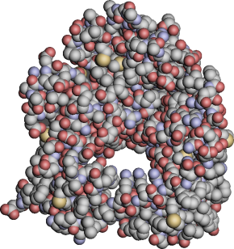
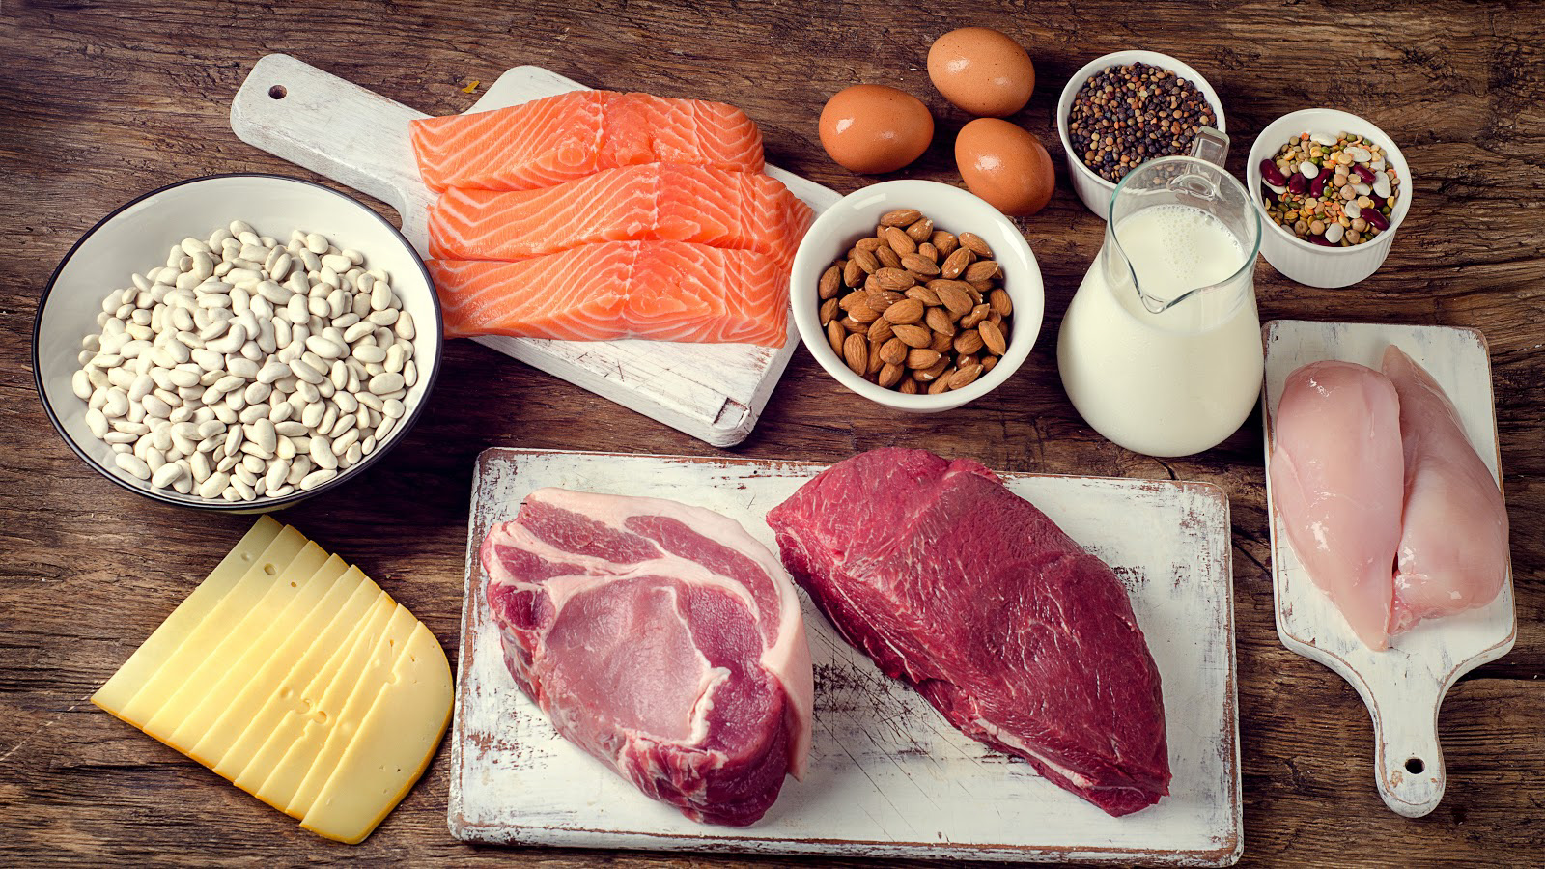
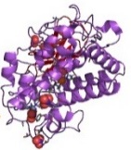
What are proteins?
Why are proteins important?

Slide 3
What is a protein?
(https://www.youtube.com/watch?v=wvTv8TqWC48)

Slide 4
Structure matches function.
Think about the difference in structure between your hands and feet. What would happen if you had feet at the ends of your arms and hands at the ends of your legs?

Slide 5
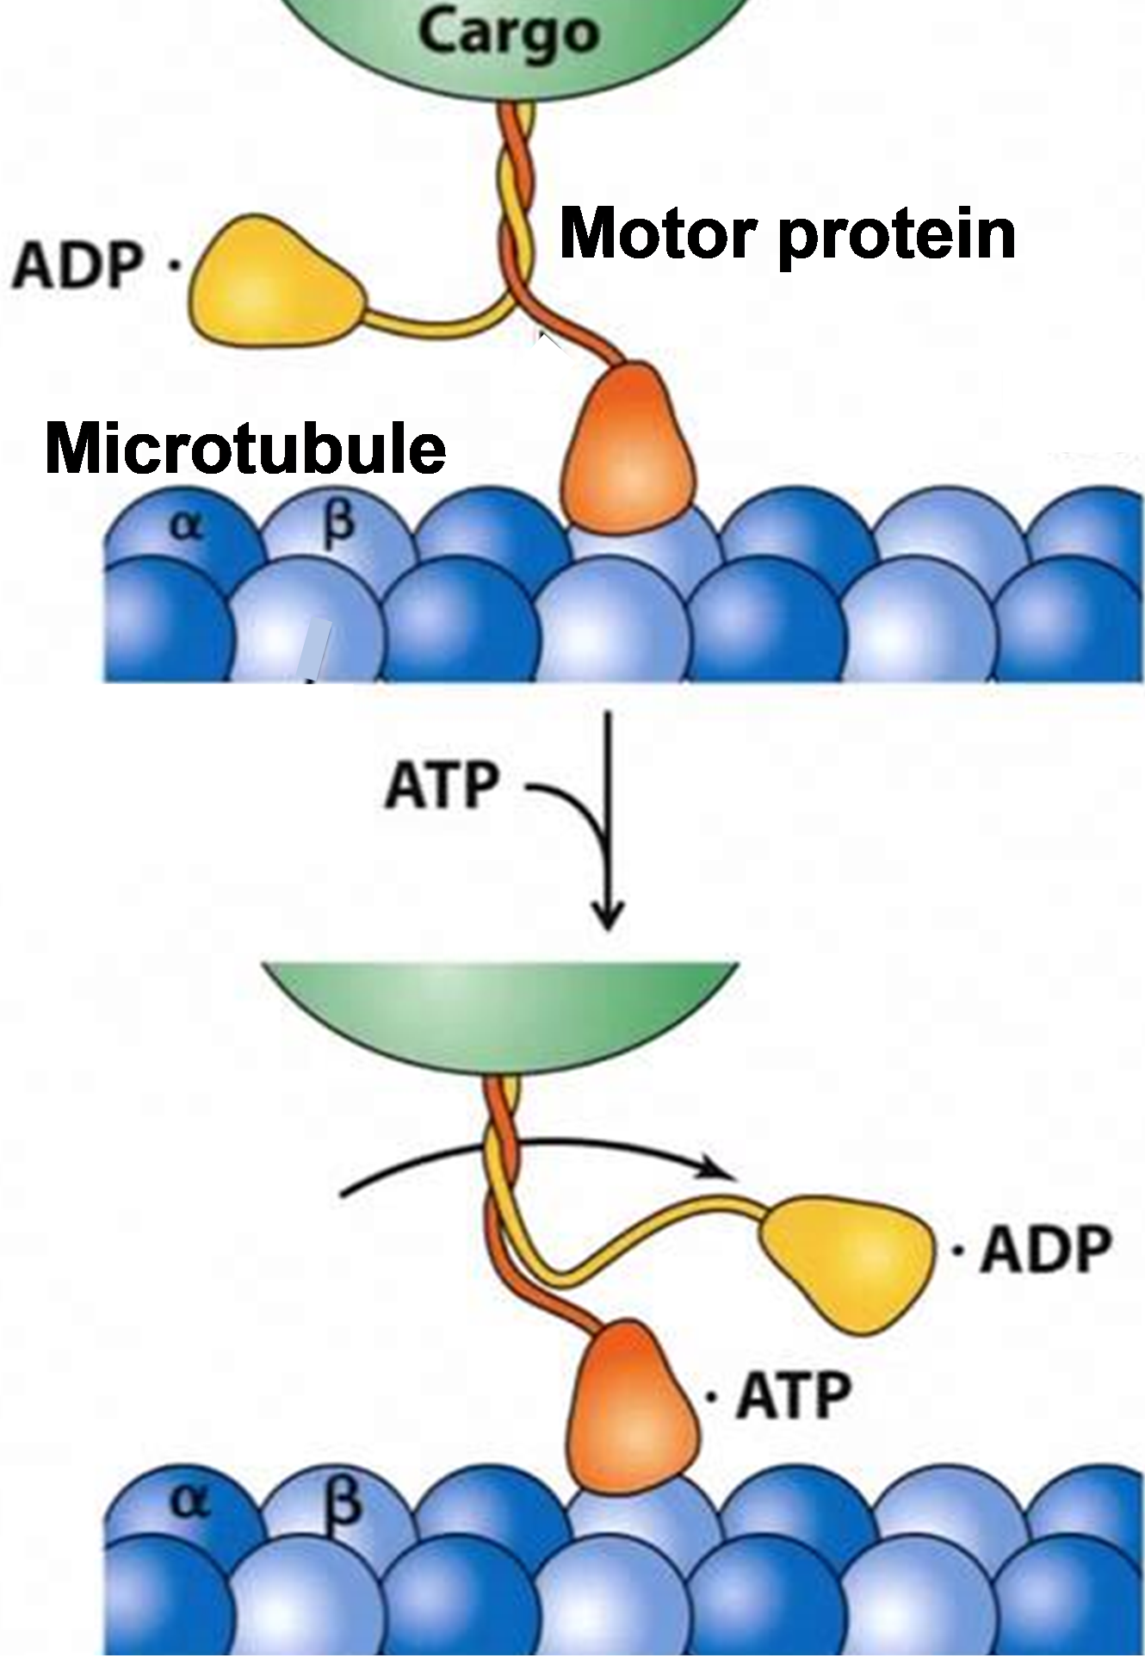
Structure matches function at the molecular level.
View the video at https://www.youtube.com/watch?v=y-uuk4Pr2i8. The motor protein “walks” along a microtubule to move a vesicle containing a chemical cargo. Microtubules are very long. They are made up of proteins.
Describe how the structures of the motor protein and the microtubule match their function.

Slide 6
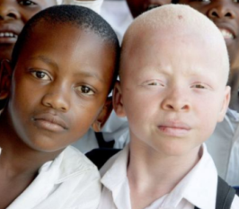
Why do different people have different characteristics?
For example, why are some
people albino?

Slide 7
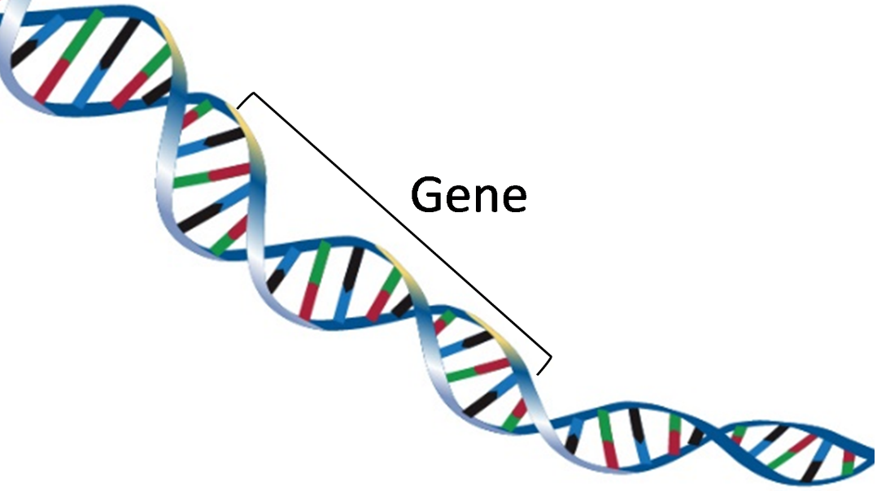
What is DNA?
Why is DNA important?
What is a gene?

Slide 8
What are DNA and genes?
(https://learn.genetics.utah.edu/content/basics/dna)
What is DNA and how does it work?
(https://www.statedclearly.com/videos/what-is-dna/)

Slide 9
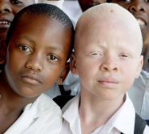
How do genes influence our characteristics?
Different versions of a gene in the DNA | → | Different versions of a protein | → | Different characteristics
 | → |  | →

Slide 10
How do genes influence our characteristics?
Gene in DNA | → | Protein | → | Characteristic
One version of a gene gives instructions to make a functional protein enzyme. | → | Functional enzyme makes melanin. Melanin is the pigment that gives color to skin and hair. | → | Normal skin and hair color
Another version of the gene gives instructions to make a non-functional version of this protein. | → | Non-functional version of protein does not make melanin. | → | Albinism (very pale skin and hair)

